Slide 1
covRes
Covariance-driven resampling for
GP dataset exploration
Frank Lumpitzsch

Slide 2
GP and how it works (or what I understood so far).

Slide 3
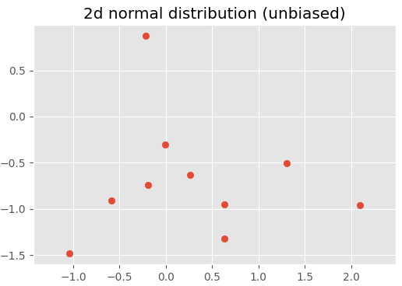
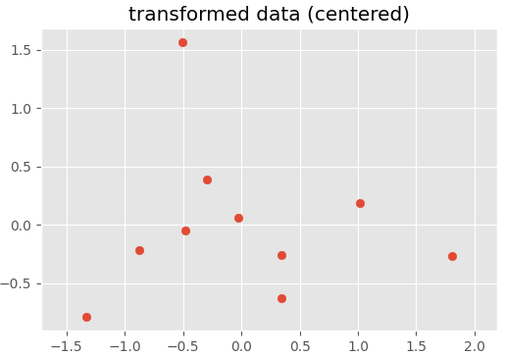
Step 1: generating a set of 10 arbitrary normal distributed datapoints and move them to mean (if not already centered, what it should normally be)
x = np.random.normal(0, 1, 50)
y = np.random.normal(0, 1, 50)
X = np.vstack((x, y)).T
X = X - np.mean(X, 0)

Slide 4
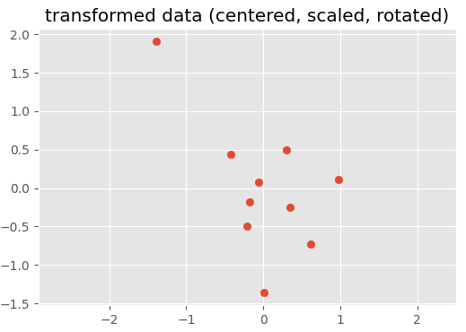
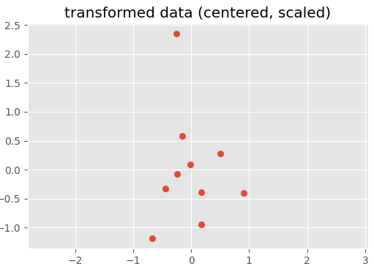
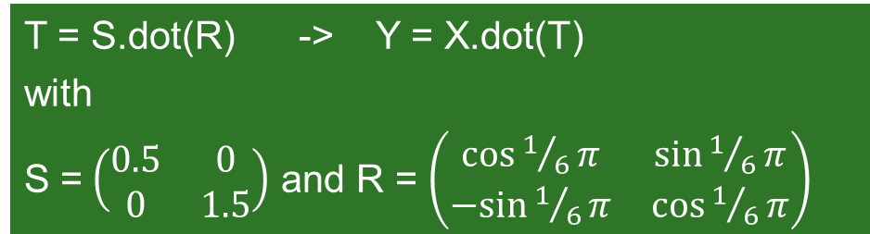
Step2: scale (arbitrary) and rotate (arbitrary)
T = S.dot(R) -> Y = X.dot(T)
with
S =$\left(\begin{matrix}0.5 & 0 \\ 0 & 1.5\end{matrix}\right)$ and R = $\left(\begin{matrix}\cos{1/6π} & \sin{1/6π} \\ −sin{1/6π} & \cos{1/6π}\end{matrix}\right)$

Slide 5
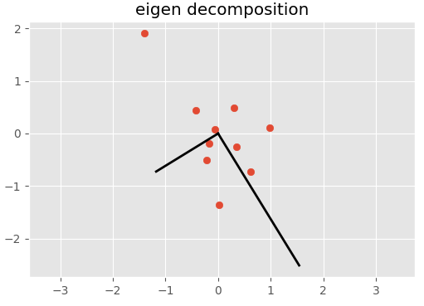
Step 3: estimate covariance matrix and perform eigenvalue decomposition
With
Eigenvectors: basis vectors of transformed data set and
Eigenvalues: non-uniform scale factors
eVa, eVe = np.linalg.eig(C)
R = eVe
S = np.diag(np.sqrt(eVa))
T = R.dot(S).T

Slide 6
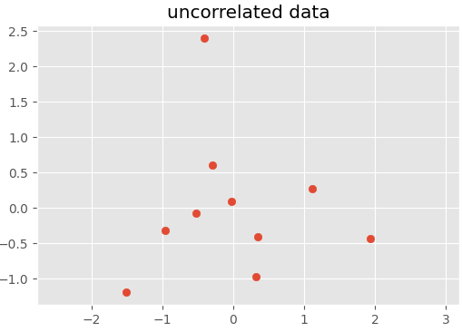
Step 4: invert transformation matrix and back-transform dataset
original (mean)
copy
T_inv = np.linalg.inv(T)
Z = Y.dot(T_inv)

Slide 7
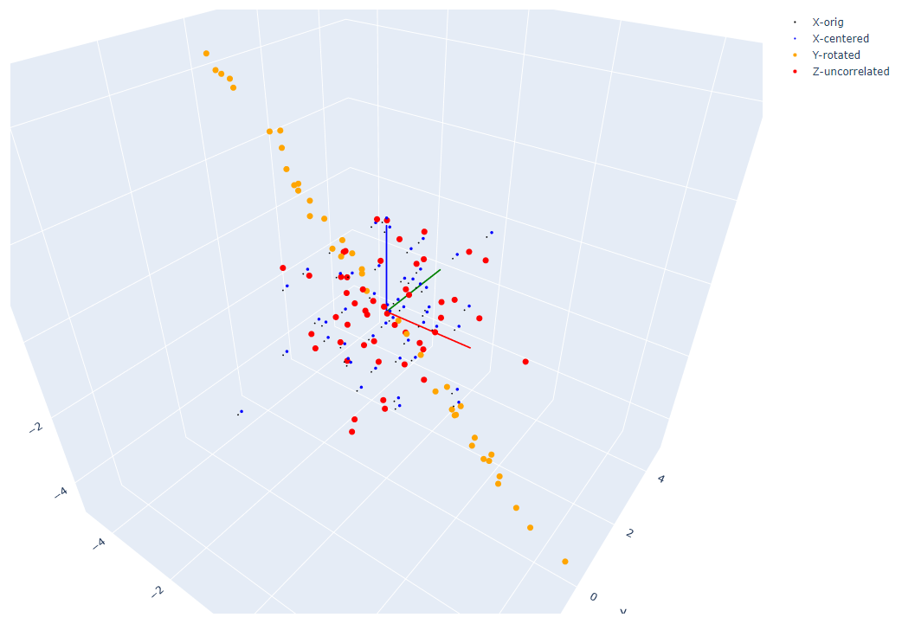
Same for higher dimensions…

Slide 8
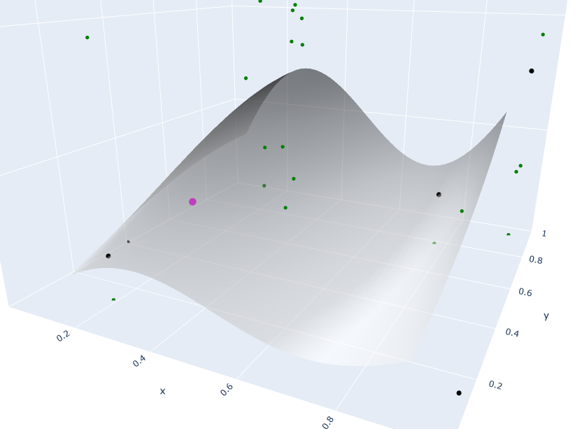
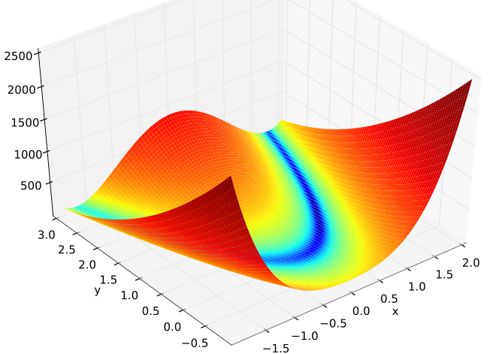
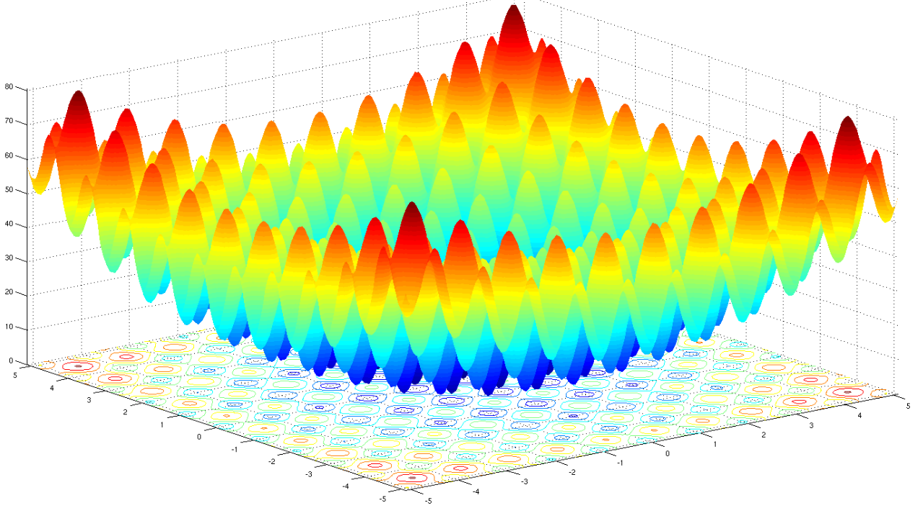
Use of step 3 and step 4 to adapt to GP
Define Problem
Setup Solution
kernel | learning alg. | max. iterations & conv. critera | exploration sample set | etc.
Generate X_train, initial X_explore, details following…
Iterate
AL_Cohn96_idx/AL_McKay92_idx taking (kernel, X_train, X_explore), returning indices of most deviant exploration points (high stdev from prediction)
covRes taking a subset of exploration points
extracting mean, S and R -> T from distribution above (expl. points)
generating a new exploration data set for the next generation using T (resample set)
limit expl. points to problem boundaries (clipping)

Slide 9
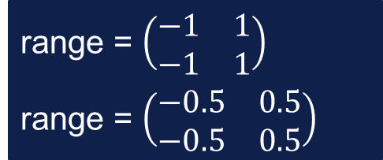
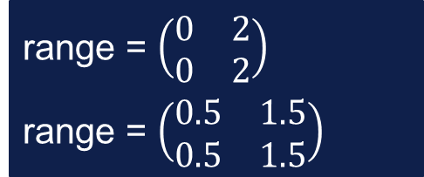

Test functions (F: R^{n}->R)
Sinoidal function
Rastrigin
Rosenbrock
range = $\left(\begin{matrix}0.1 & 0.9 \\ 0.1 & 0.9\end{matrix}\right)$
range = $\left(\begin{matrix}−1 & 1 \\ −1 & 1\end{matrix}\right)$
range = $\left(\begin{matrix}−0.5 & 0.5 \\ −0.5 & 0.5\end{matrix}\right)$
range = $\left(\begin{matrix}0 & 2 \\ 0 & 2\end{matrix}\right)$
range = $\left(\begin{matrix}0.5 & 1.5 \\ 0.5 & 1.5\end{matrix}\right)$
Complexity

Slide 10
Convergence criteria
eps x-validation score
eps mean(std)
of X_resample
eps deviation
score = -np.log(score)
-> min
gp.predict(X):mu, std
AL: ixs->X_ixs
->X_resample
mean(std(X_resample))
X_prove meshgrid
F(X_prove)-> val gp.predict(X_prove) -> mu
0.05..0.1
0.5..0.1
0.5..0.1 * sqrt(dim)

Slide 11
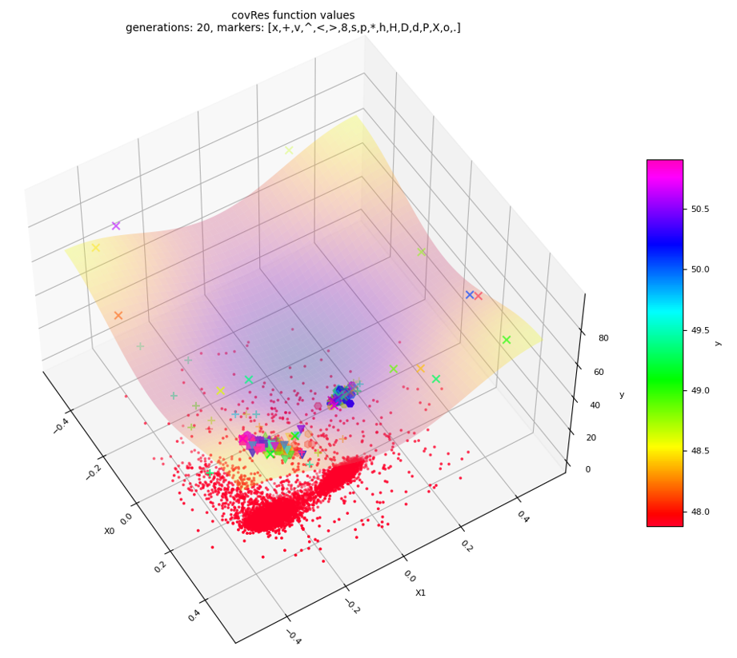
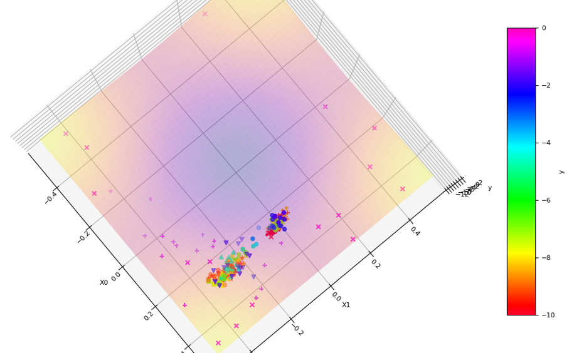
How it works
Function values

Slide 12
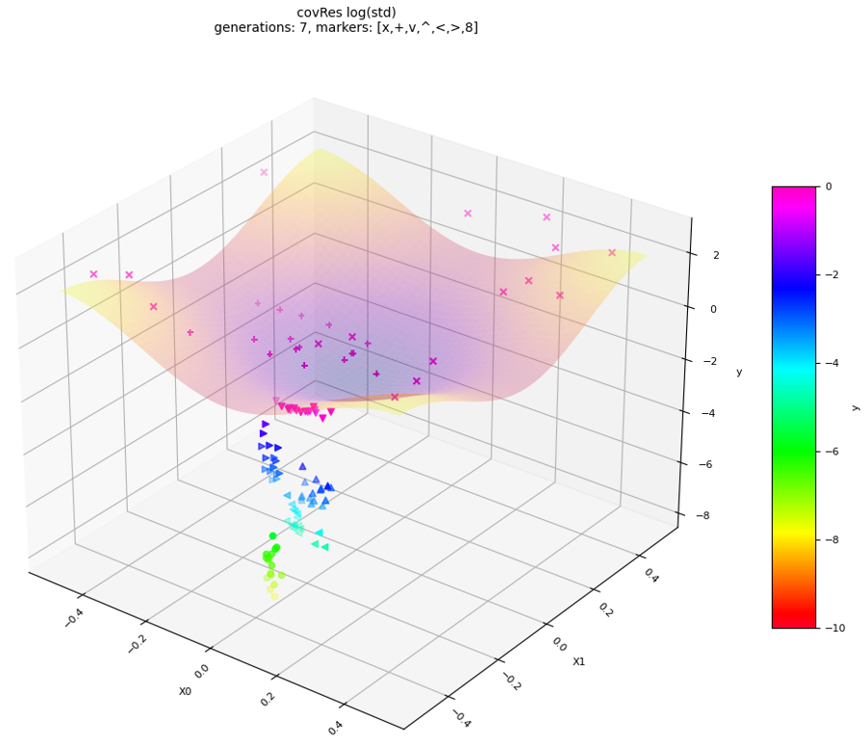
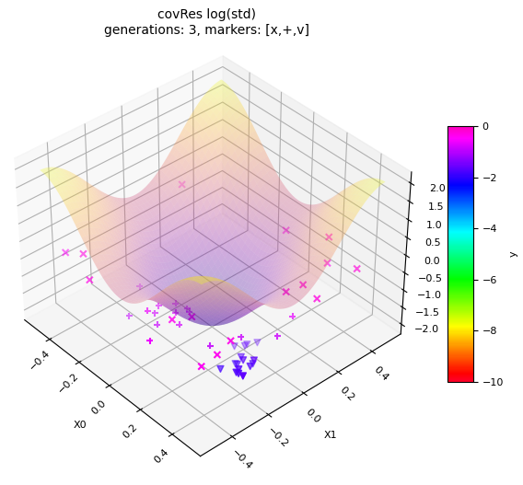
How it works
log(std)

Slide 13
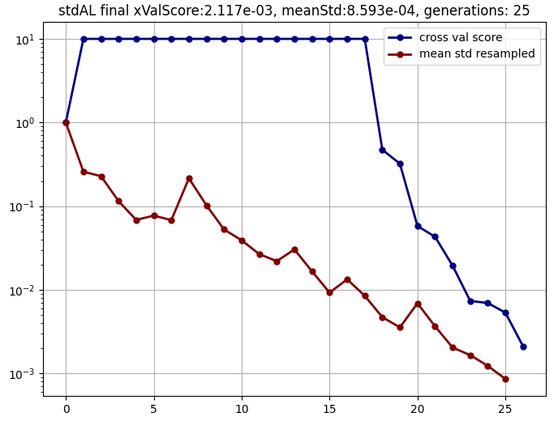
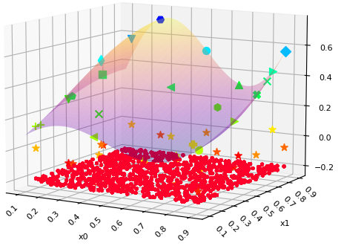
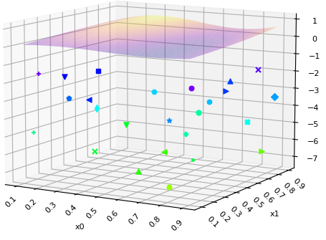
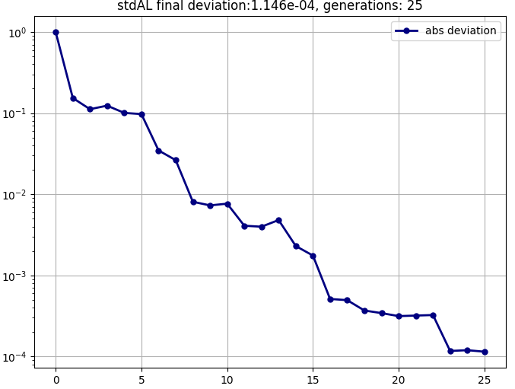
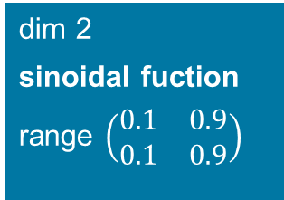
Benchmark stdAL sin
Problem
dim 2
sinoidal fuction
range $\left(\begin{matrix}0.1 & 0.9 \\ 0.1 & 0.9\end{matrix}\right)$
Solution
maxIter: 100
method: stdAL
alg: Coehn96
kernel: RBF(1/3)
nInitial: 5
nExplore: 1000
nIxs: 1
nResample: 1
generations: 25, function calls: 30
epsScore:0.01, epsStd:0.001, epsDev:0.1

Slide 14
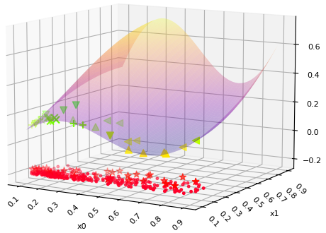
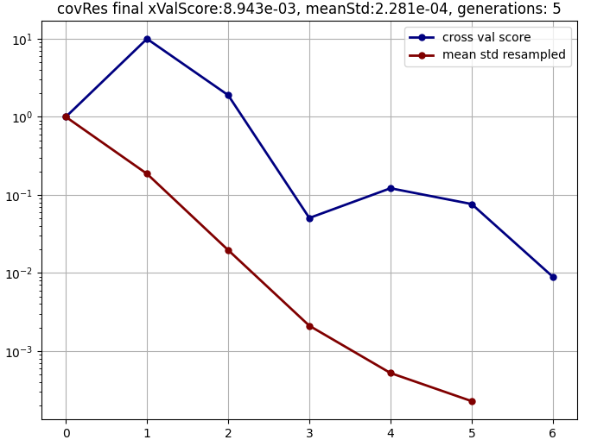
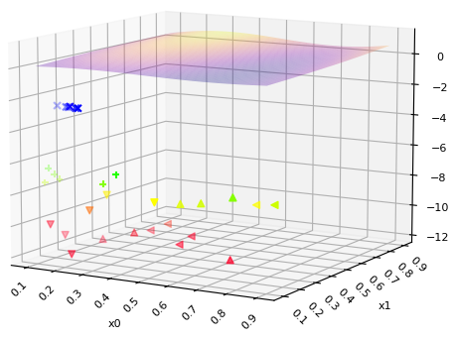
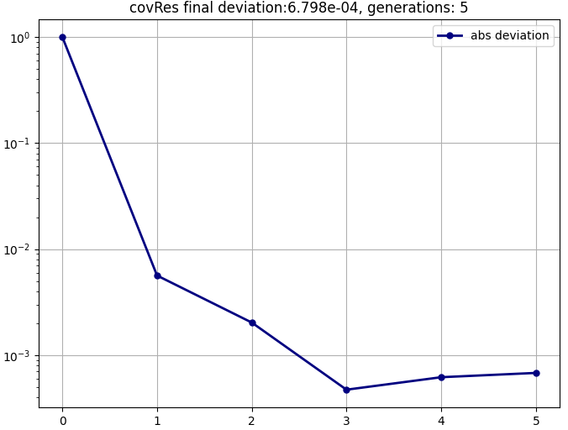
Benchmark covRes sin
Problem
dim 2
sinoidal fuction
range $\left(\begin{matrix}0.1 & 0.9 \\ 0.1 & 0.9\end{matrix}\right)$
Solution
maxIter: 100
method: covRes
alg: Coehn96
kernel: RBF(1/3)
nInitial: 16
nExplore: 1000
nIxs: 8
nResample: 6
epsScore:0.01, epsStd:0.001, epsDev:0.1
generations: 5, function calls: 46

Slide 15
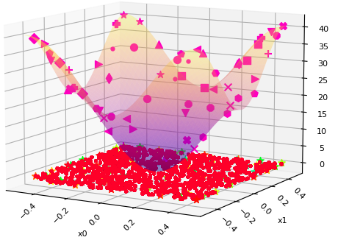
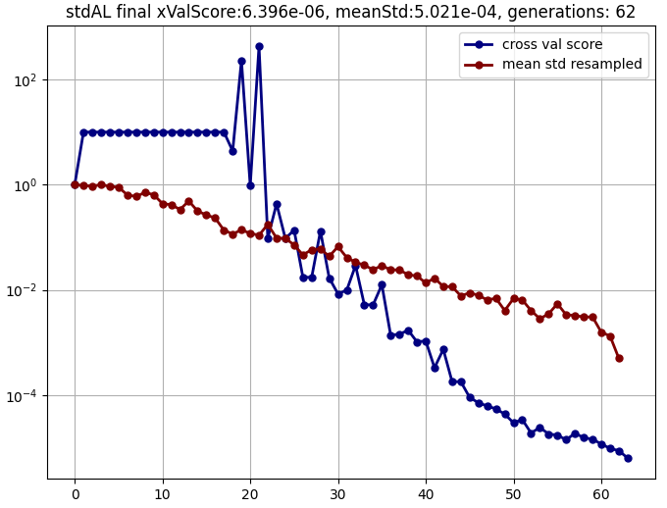
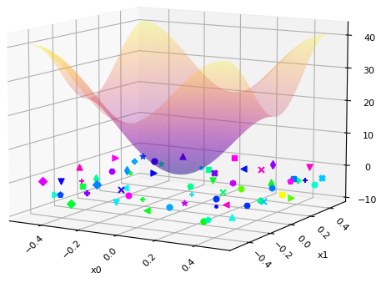
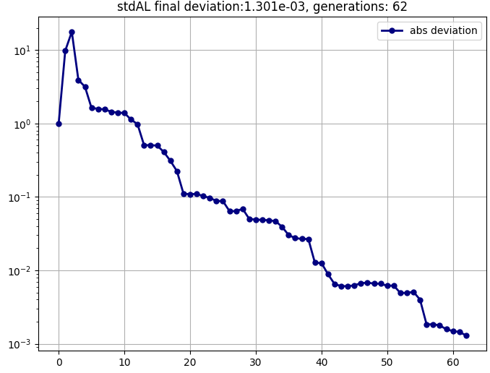
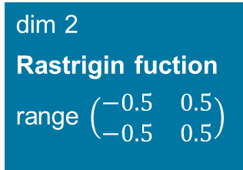
Benchmark stdAL Ras
Problem
dim 2
Rastrigin fuction
range $\left(\begin{matrix}−0.5 & 0.5 \\ −0.5 & 0.5\end{matrix}\right)$
Solution
maxIter: 100
method: stdAL
alg: Coehn96
kernel: RBF(1/3)
nInitial: 5
nExplore: 1000
nIxs: 1
nResample: 1
generations: 62, function calls: 67
epsScore:0.01, epsStd:0.001, epsDev:0.1

Slide 16
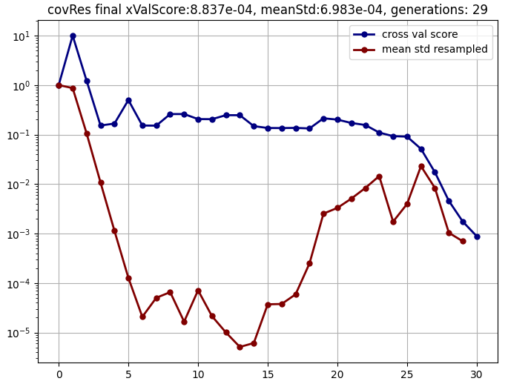
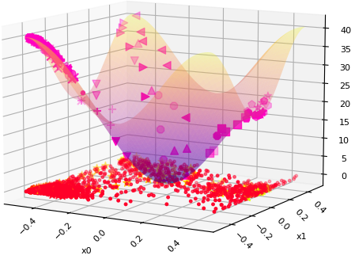
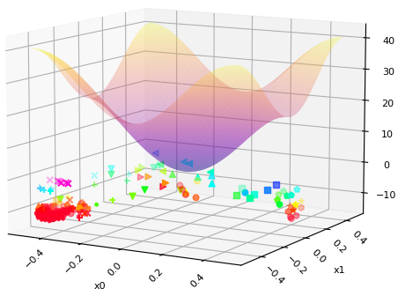
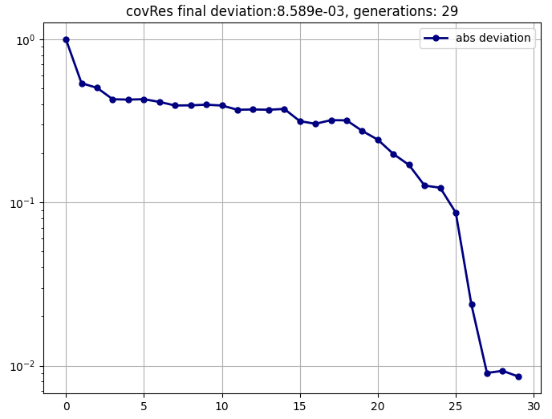
Benchmark covRes Ras
Problem
dim 2
Rastrigin fuction
range $\left(\begin{matrix}−0.5 & 0.5 \\ −0.5 & 0.5\end{matrix}\right)$
Solution
maxIter: 100
method: covRes
alg: Coehn96
kernel: RBF(1/3)
nInitial: 16
nExplore: 1000
nIxs: 8
nResample: 6
generations: 29, function calls: 190
epsScore:0.01, epsStd:0.001, epsDev:0.1

Slide 17
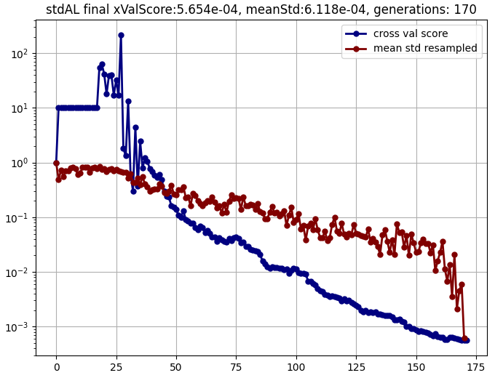
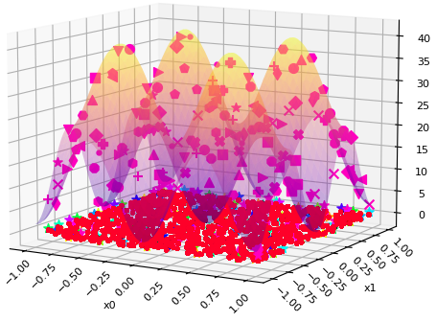
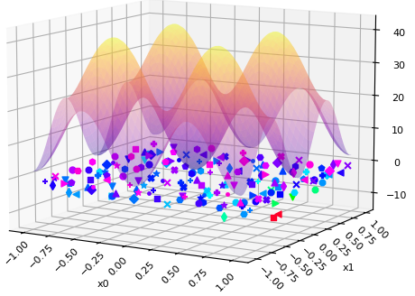
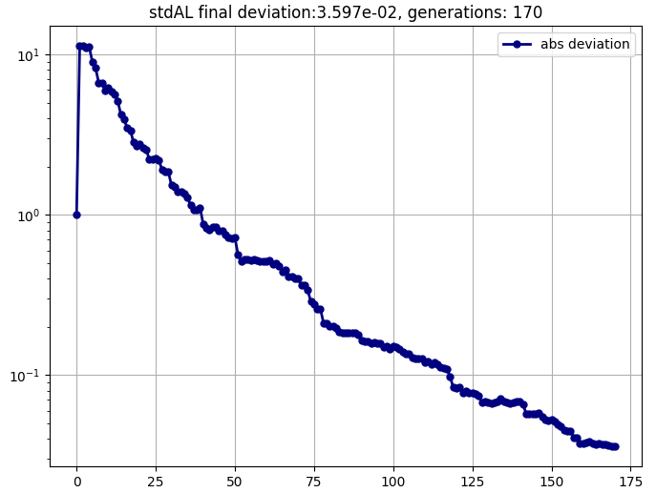
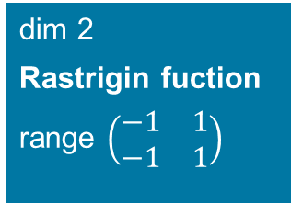
Benchmark stdAL Ras
Problem
dim 2
Rastrigin fuction
range $\left(\begin{matrix}−1 & 1 \\ −1 & 1\end{matrix}\right)$
Solution
maxIter: 200
method: stdAL
alg: Coehn96
kernel: RBF(1/3)
nInitial: 5
nExplore: 1000
nIxs: 1
nResample: 1
generations: 170, function calls: 175
epsScore:0.01, epsStd:0.001, epsDev:0.1

Slide 18
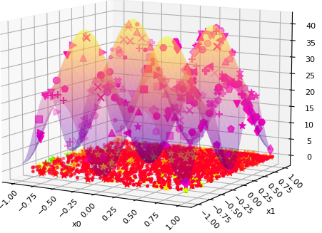
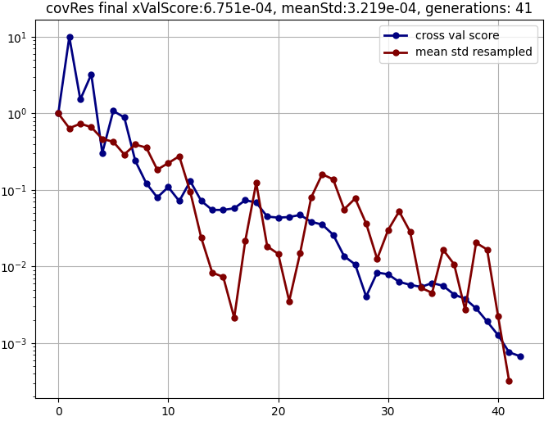
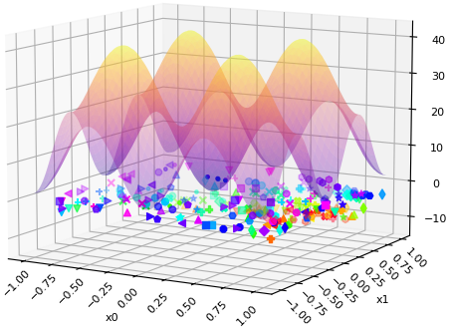
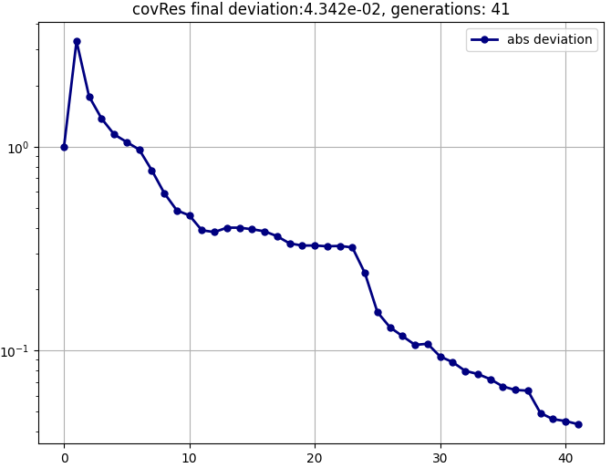
Benchmark covRes Ras
Problem
dim 2
Rastrigin fuction
range $\left(\begin{matrix}−1 & 1 \\ −1 & 1\end{matrix}\right)$
Solution
maxIter: 100
method: covRes
alg: Coehn96
kernel: RBF(1/3)
nInitial: 16
nExplore: 1000
nIxs: 8
nResample: 6
generations: 41, function calls: 262
epsScore:0.01, epsStd:0.001, epsDev:0.1

Slide 19
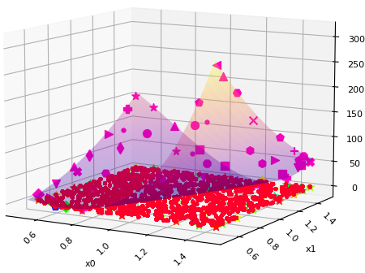
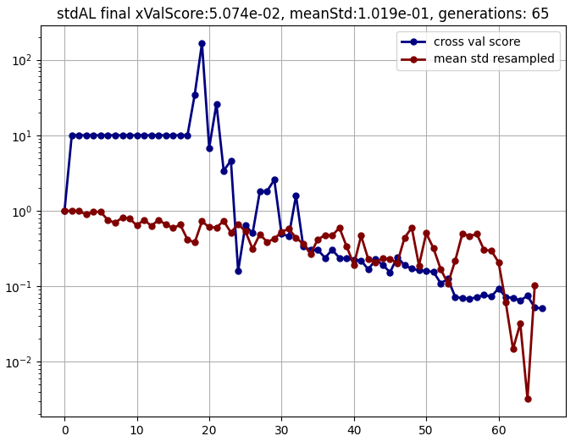
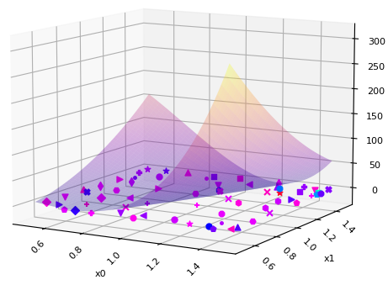
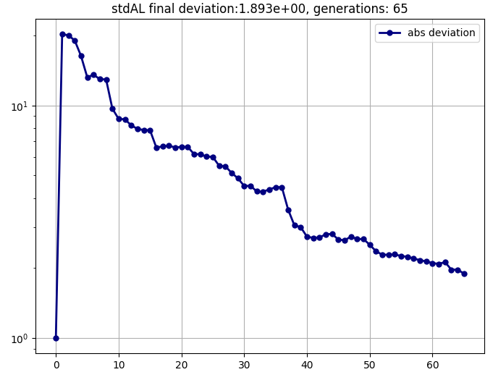
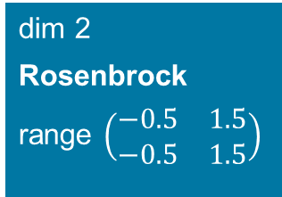
Benchmark stdAL Rosen
Problem
dim 2
Rosenbrock
range $\left(\begin{matrix}−0.5 & 1.5 \\ −0.5 & 1.5\end{matrix}\right)$
Solution
maxIter: 65
method: stdAL
alg: Coehn96
kernel: RBF(1/3)
nInitial: 5
nExplore: 1000
nIxs: 1
nResample: 1
Failed at 66!
epsScore:0.01, epsStd:0.001, epsDev:0.1

Slide 20
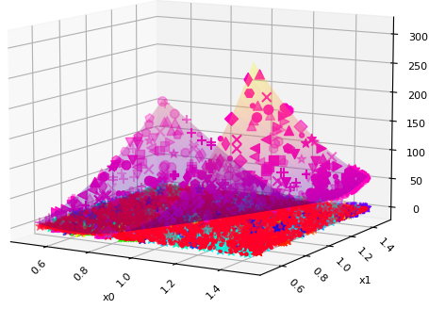



Benchmark covRes Rosen
Problem
dim 2
Rosenbrock
range $\left(\begin{matrix}−0.5 & 1.5 \\ −0.5 & 1.5\end{matrix}\right)$
Solution
maxIter: 200
method: covRes
alg: Coehn96
kernel: RBF(1/3)
nInitial: 16
nExplore: 1000
nIxs: 8
nResample: 6
generations: 112, function calls: 688
epsScore:0.01, epsStd:0.001, epsDev:0.1

Slide 21





Benchmark stdAL Rosen
Problem
dim 2
Rosenbrock
range $\left(\begin{matrix}0 & 2 \\ 0 & 2\end{matrix}\right)$
Solution
maxIter: 160
method: stdAL
alg: Coehn96
kernel: RBF(1/3)
nInitial: 5
nExplore: 1000
nIxs: 1
nResample: 1
Failed at 161!
epsScore:0.01, epsStd:0.001, epsDev:0.1

Slide 22





Benchmark covRes Rosen
Problem
dim 2
Rosenbrock
range $\left(\begin{matrix}−0.5 & 1.5 \\ −0.5 & 1.5\end{matrix}\right)$
Solution
maxIter: 200
method: covRes
alg: Coehn96
kernel: RBF(1/3)
nInitial: 16
nExplore: 1000
nIxs: 8
nResample: 6
generations: 175, function calls: 1066
epsScore:0.01, epsStd:0.001, epsDev:0.1

Slide 23




Benchmark stdAL Ras
Problem
dim 5
Rastrigin
Range {-0.5, 0.5}
Solution
method: stdAL
alg: Coehn96
kernel: RBF(1/3)
nInitial: 2**(dim-1)
nExplore: 1000
nIxs: 1
nResample: 1
generations: 431, function calls: 495
epsScore:0.05, epsStd:0.1, epsDev:0.1*sqrt(dim)

Slide 24




Benchmark covRes Ras
Problem
dim 5
Rastrigin
Range {-0.5, 0.5}
Solution
method: covRes
alg: Coehn96
kernel: RBF(1/3)
nInitial: 2**(dim-1)
nExplore: 16*2**dim
nIxs: nInitial/2
nResample: nInitial/4
epsScore:0.05, epsStd:0.1, epsDev:0.1*sqrt(dim)
generations: 46, function calls: 710

Slide 25
Known problems (so far)
the identified resampling indices may not be located in their nearest vicinity (e.g. at local minima or the initial exploration set is too small) and thus the resample set may be some kind of ill-shaped
if this happens, subsequently the need of multiple resample set is not taken into account
the resample set may be too large or too small and thus requiring some uniform scale
the resample points may all laying outside the problem boundaries and will be neglected, following the algorithm gets stuck

Slide 26
Next steps
Discuss the potential
Implement multi-region-covRes
Test with more functions, real problems

Slide 27
References
N. Hansen: The CMA Evolution Strategy: A Tutorial, https://arxiv.org/pdf/1604.00772.pdf, 4th April 2016
https://google.com/search images
https://en.wikipedia.org/commons
A geometric interpretation of covariance matrix, https://www.visiondummy.com/2014/04/geometric-interpretation-covariance-matrix/

Slide 28
BACKUP SLIDES

Slide 29
Colour palette
Sky blue
Digi green
Pine forest
Land green
Earth
Sea blue
Eucalyptus
Sunflower
Primary
Dark blue
Secondary
Lavender
Cyan
Sandstone
Cognac
White
Warm grey
Black
Energy red

